Slide 1


Backpacks and BodyBags
- Mathias Drgon -

Slide 2
Our Team -
Coding ~ me, Mathias Drgon, Ph.D
Creative Direction ~ me, Mathias Drgon, Ph.D
Art Direction ~ me, Mathias Drgon, Ph.D
PreFabrication ~ me, Mathias Drgon, Ph.D
Assistant Dolly Grip ~ me, Mathias Drgon, Ph.D
Lead Designer ~ me, Mathias Drgon, Ph.D
Music ~ RichaadEB on youtube (unlicensed)
Name ~ John Goco

Slide 3

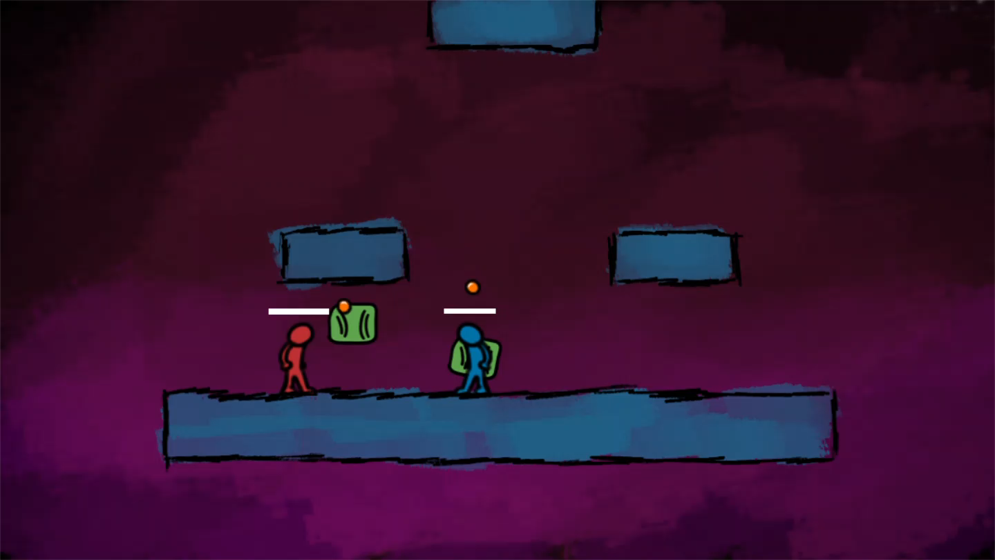
Overview -
Dogtags and Bodybags is multiplayer arena fighter inspired by this cool youtube video I saw:

Slide 4
Gameplay -
Players have two attacks available to them: a punch and a backpack.
The punch commits you to about a 20 frame animation during which you are vulnerable.
Throwing the backpack does more damage and doubles as movement mechanic but leaves you vulnerable when you aim and throw. It is also much more telegraphed than the punch
Losing your backpack off the stage doesn’t mean the game is over for you, but you’re only restricted to jumping and punching, teleporting to the backpack kills you
There’s also a block, 4 frame delay to enter and exit it, and you’re immune to all damage

Slide 5
Roadmap -
I plan on tabling this as a solo project and joining someone else’s team, but if I were to continue development, I would aim for a 2.5D arena fighter with a small selection of characters and the ability to swap place with projectiles and teleport in different ways
This would require
Reworking the underlying movement and combat logic
Switch to an engine that better supports 2.5D games(maybe)
A flexible system for aiming and swapping with physics objects
Model environments, characters, create music and particle effects

Slide 6
